Slide 1
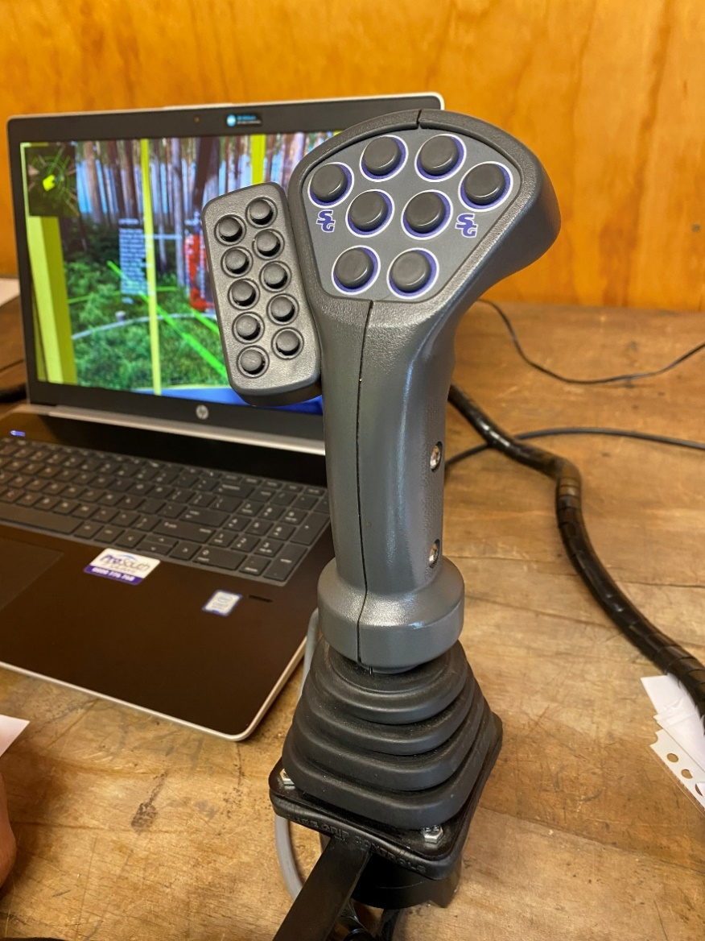
6.6 NEW STANDARDS
  Longitudinal Study
    Sponsoring the 2024 and 2025 cohorts of the NZ Apprenticeship in Forest Harvesting to evaluate the program
    Value is assumed to be a function of:
      1. Nature of the recruits (education; work history)
      2. Program effectiveness in developing knowledge/skills
      3. Subsequent employment pathways accessed
    Work to date: interviewing to understand the nature of recruits attracted to the program.
  Tech Note re 2024 Cohorts block course experience: see HTN17-05

Slide 2
Retention Analysis
Cohort | Year | # Participants | # Completed | # Still Completing | # Employed in Logging / Forestry
1 | 2020 | 8 | 7 | 1 | 8
2 | 2021 | 8 | 4 | 0 | 5
3 | 2022 | 10 | 4 | 5 | 9
4 | 2023 | 6 | 2 | 1 | 3
5 | 2024 | 6 | 3 | 1 | 5
6 | 2025 | 8 |  | 8 | 8
 |  | 46 | 20 | 19 | 38
 |  |  | 43.5% | 34.8% | 82.6%
Next Step:
final block course interviews on 2025 cohort
Post completion interview with any from 2024 cohort that have completed their Certificate.

