Slide 1


Industry engagement on proposed changes to forestry training
11 and 12 February 2026
Kevin Ihaka, Chair of the Joint-Training Committee
Rowan Struthers, FICA
Joseph Brolly, FOA
Notes:
Introduce Competenz and PrimaryITO – in the room (united front) and can field technical questions

Slide 2
Introduction
Changes to forestry training are underway following government reform of vocational education and the disestablishment of Te Pūkenga and the work-based learning divisions, including Competenz
We are working with current providers to develop a proposal that will be presented and accepted by the Tertiary Education Commission and NZQA
Timelines are tight and we need to help shape the new system and organise ourselves to make the most of the opportunities
Seeking support for the proposed model to implement change

Slide 3
Government has directed change
Te Pūkenga was New Zealand's national vocational education entity, formed by merging all polytechnics and some Industry Training Organisations (ITOs) into a single "mega-polytechnic" (NZIST)
Changes to the Education and Training (Vocational Education and Training System) Act disestablishes the centralised model created under Te Pūkenga and enables the re-establishment of regionally governed polytechnics
It also establishes eight Industry Skills Boards to lead standard-setting, qualification development and temporarily manage work-based training across defined industry groups. These are operational since January 2026.

Slide 4
Government has directed change
The objectives are to
  Restore regional decision-making for New Zealand’s polytechnics
  Improve financial accountability and transparency, and
  Strengthen industry leadership in work-based training.
The opportunity is to building a vocational education and training system that’s locally and industry-led, regionally responsive, and future focused

Slide 5
Competenz will become a PTE
Competenz has been engaging with its 36 sectors for over 18 months on the latest Government changes and helped them to agree on their preferred training provider.
Through this ongoing engagement, the majority of Competenz sectors are working to establish an industry owned, Engineering and Manufacturing PTE in 2027.
Competenz has been working with the Forestry Training Committee, alongside commissioning several reports, that has helped the Committee and the FOA/FICA boards agree that Foresty Training does not fit with this new Engineering and Manufacturing focused PTE.

Slide 6
The Forestry Industry welcomes this change
Forestry employers find the vocational system complex and confusing to understand and use and question the level of costs associated with training
This industry-led, or "pull," approach would ensure that training is delivered at the right time, in the right place, and in the right form, allowing industries to upskill staff in line with operational and market needs.
We are aiming representation at the ISB level and through governance of a food and fibre PTE we can lobby for systemic change to support our preferred delivery model.

Slide 7
Training in the Forestry Industry
Forestry is the country’s fourth largest export earner.
Employs nearly 8,500 people across the supply chain from forest silviculture, harvesting, engineering and management.
Forestry training requires intensive, high-input instruction for a small number of learners, making it unsuitable for traditional classroom-based teaching.
Training and assessment are typically conducted one-on-one rather than in cohorts, as hands-on experience is essential.
Most of the training, assessment and pastoral care of these employees is provided by in-house capability with at least 85% of this training being work-based.

Slide 8
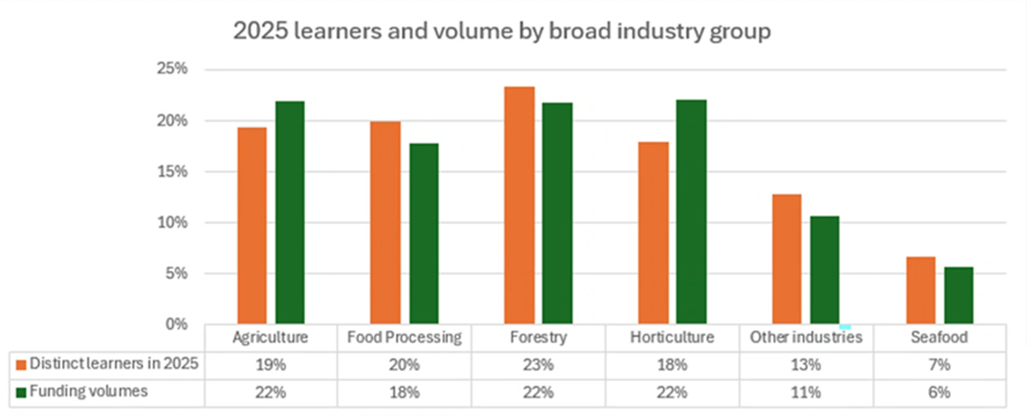
Forestry learners are a big part of the system
In 2023, a total of 3,400 individuals were enrolled in forestry qualifications, with 47% enrolled at NZQF Level 3 and 48% at Level 4.
Proportion of work-based learners:
Notes:
Graph from Primary ITO
Kevin to comment “Some of the current quals run at financial losses (e.g. the microcredentials) and this needs to be balanced out in any new entity”

Slide 9
What we want to achieve
Ensure that the intellectual property, resources, relationships, and key staff currently supporting forestry training at Competenz are transferred to the new provider
The existing national network of trainers and assessors continues
Training remains learner-focused and straightforward for employers to organise
We want to see an increase in
  Transparency
  Control over content and quality
  Monitoring performance and delivery

Slide 10
The timeline is tight
Forestry intends to inform the Government of its preferred option for delivering vocational training by March this year.
Competenz and Primary ITO aiming to cease December 2026 and new entity commences January 2027
March 2026
July 2026
June -July 2027
By January 2028
Agreement of food and fibre sector on way forward
Presenting preferred model to TEC
TEC provides process to new work-based learning providers
Investment plans to TEC
Transition plans and agreement on learner transitions for 2027
Enrolment of new learners
Investment plans for 2028 due
Wind down of existing work-based learner subsidiaries
Current provider disestablished
New network operational

Slide 11
Landing the preferred model
The options are to align with a polytechnic, a private training establishment, or a wānanga
FICA and FOA Forestry Training Committee has completed due diligence on the available options through 2025
Our preferred option is for the current Primary ITO to transition into a Food and Fibre Industry private training establishment
Under this model, forestry would have its own business unit with oversight from an industry advisory group to support accountability and transparency

Slide 12
Landing the preferred model
Forestry having its own business unit is important to us
The proposed forestry business unit within this private training establishment would focus only on vocational training, similar to the role previously played by Competenz.
It would not be a single provider or “one stop shop” for all forestry training. Forestry diplomas, forestry science degrees, and other programmes would continue with their existing providers.
Other Private Training Establishments, Polytechs and Wānaga would also be able to operate in the forestry training market.

Slide 13
Our preferred model
Forestry Governance
(representative on PTE Board)
PTE Board
Private Training Establishment
Food and Fibre PTE Board
Food and Fibre PTE Head Office
Forestry Advisory Group
Seafood and other industries
Food processing
Horticulture
Agriculture
Forestry
Training
Notes:
NZQA, TEC, and ISB Other industry still confirm

Slide 14
Opportunities for a system reset
  We can
  Positively and proactively shape and influence the training reset for the industry
  Influence in where surpluses generated by the sector in training are invested
  Have a seat on the Board
  Retain the Forestry Training Committee, with this entity having a tight connection back to PTE and ISB
  Avoid subsidising other industries or be de-prioritised because of other sectors powerful lobby groups
  Achieve greater transparency of financials, overheads and where surpluses are invested.
  Demand that each industry to operate as a business unit where it makes sense, with its own industry advisory group to assist with feedback and accountability. The FTC could be the industry advisory group for forestry.
  Drive for a one-stop shop for forestry vocational training.

Slide 15
We seek industry endorsement
Government requires us to undertake industry engagement and demonstrate support
This meeting is part of that, followed by wider industry and contractor engagement planned:
We will require a letter of support from you
The next step is creating the entity and our industry supporting this process to ensure our objectives are met
Date | Place
4th of March | Whangarei
6th of March | Rotorua
11th of March | Gisborne
30th of March | Balclutha
31st of March | ONLINE
1st of April | Nelson

Slide 16
Questions
Do you support this model?
What is working well?
What needs to change?
What other training needs do you have that could be filled by Polytechs or ITPs?
Any risks or concerns you see with the proposed approach?

Slide 17
Additional slides to follow
In case there are more questions about timelines and transitional arrangements

Slide 18
The timeline for transition is tight
2025
2026
Beyond 2026
Standard Setting
Workforce Development Councils
Industry Skills Boards
Industry Skills Boards
Industry Engagement
Institutes of Technology & Polytechnics
TWOA & PTEs
Te Pūkenga
Work-based Learning
Polytechnics
Institutes of Technology & Polytechnics
TWOA
& PTEs
TWOA & PTEs
(Transitional) Work-based Learning
Delivery
TWOA – Te Wananga o Aotearoa
PTEs – Private Training Entities
Notes:
Transition of workbased learning (WBL)

Slide 19
The timeline for transition is tight
Q1 2026 Q2 2026 Q3 2026 Q4 2026 Q1 2027
Ownership Structure landed
Governance landed
Legal entity(s) established
Endorsed by EAG
Business Plan and Budget endorsed by new Board + EAG
QMS completed
Ownership & Governance endorsed by TEC
Sector engagement
Functional transition of exiting sectors to new PTEs (not financial transition)
Transition actions from ISB to PTE
Full transition of exiting sectors
Fully transitioned from ISB to PTE
REQUIRED
BY NZQA
PTE
Application
Submission
PTE
Application
Approval
4 – 8 months
for NZQA Approval
REQUIRED
BY TEC
Mix of Provision
Investment Plan
Transition Plan
TEC Submission may be required (upon NZQA PTE Approval)
Notes:
Transition of workbased learning (WBL)

Slide 20
Food & Fibre Private Training Establishment (EXAMPLE)
PTE is a Limited Liability Company with charitable status (more agility and flexibility than an Incorporated Society e.g., to raise capital)
Proportionate representation by sector shareholders (in constitution % can be recalculated if significant change)
8 Board members (2 independent, incl. a shareholder convenor)
Shareholders vote board members and any major/reserved matters
Shares have zero value, no buy-in, or dividend

Slide 21
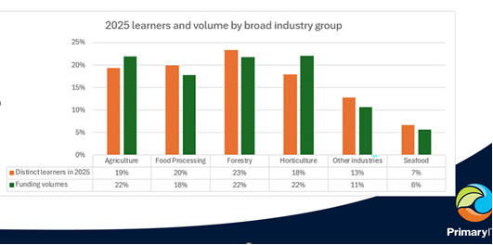
SHARE ALLOCATION and Directors
1
1
1
1
1

